Slide 1
Setting up a Cloud Analytics Infrastructure December 2017

Slide 2
About LatentView Analytics

Slide 3

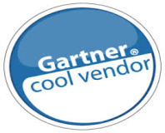
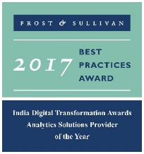




LatentView at a glance
Awards & Recognition
Founded in
Over
Grown
Work with
530
11
25+
2006
Strong Performer - Customer Analytics Services, 2017
people strong
times in last
six years
Fortune 500
firms
Member of
Frost & Sullivan, ranked us
Only company recognized
2009-2016
Technology council
#1
9
>85%
4/5
Analytics Company of the Year 2015
consecutive times in Deloitte Technology Fast50
Top technology companies work with us
Repeat
Business

Slide 4
Our Approach
We empower customers in their transformation journey by helping them move up the analytics maturity curve through actionable insights that leads to data-driven decisions that achieve business goals.
MATH
ACTIONABLE
DATA
INSIGHTS
BUSINESS
TECHNOLOGY

Slide 5




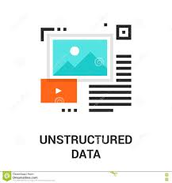
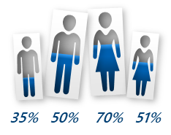

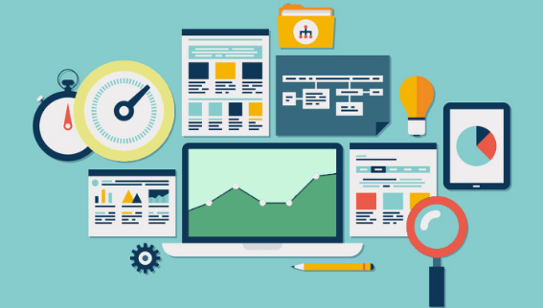

What we Do?
Reporting & Dashboards
Digital & Social Media Analytics
Data Engineering for Analytics
Foresight
Hindsight
Prediction & Forecasting
Analytics
Insight
Unstructured Data Analysis
CRM Analytics
Segmentation & Clustering
Web Analytics
Survey Analytics

Slide 6
Enabling a Cloud Platform for Advanced Analytics

Slide 7
LatentView’s Data Engineering Capabilities
Applications
Data Strategy
Data Lakes
Data Warehouse
Visualization
Decision management systems
IoT Applications
Data Monetization Roadmap
Cloud Strategy & Architecture
Architecture Evolution
Data Integration / Consolidation / Harmonization Framework
Optimizing BI Investments
Data Engineering
Capabilities
Technology
Engineering
Hadoop: Hive, HBase, MapReduce, PiG, HDFS, Phoenix
Spark – Scala, Python, Spark SQL
Flume, Kafka, NiFi, Sqoop
Spark Streaming, Storm
AWS, Azure
Structure Data Flows
Ingest streaming & batch data
Data storage and data model
Batch and Real time processing
Real-time, Graph, Search & Iterative workloads
Orchestration
OCM & Managed Services
Organizational Change Mgmt
Governance
Maturity Assessments

Slide 8
Architecting for the Cloud: Guiding Principles
The strength of your platform and data will determine the possibilities of your analytics
Business-focused Approach
start small
scale later
collect benchmark data
Workload-centric Architectures
Create a Central Ground Truth
continued evolution
scalable testing and simulation
Optimize Scale, Fit & Cost
Notes:
Architecting for the cloud means you can start small, don’t have to plan for capacity, or have any real capacity constraints. This means, the way you’d design your workloads would be very different, without really bothering about some of the traditional constraints that you have in terms of scale and capacity. You can start small, scale later
Continuous evolution means you don’t have to boil the ocean to make the best architectural choices. Cloud allows you to swap in and out components quickly so you can fail fast and learn. Based on your knowledge and requirement you can add incremental complexity to your architecture
You can run experiments with your workloads, scale it up, collect data and shut it down. This way, you can make architectural choices based on benchmarks. For example, you can benchmark instance families, instance types for databases, compute and storage instances and base your architectural decisions on this
You can simulate real world tests using a large scale testing environment and then shut it down, without incurring much cost. This is unlike the on premise world

Slide 9
Architecting for the Cloud: Key Considerations
Performance
Benchmark & Load Test
Optimize Components
CloudWatch based monitoring
New Resource Review
Reliability
Limits management
Network topology
Auto-scaling & Testing
Monitoring
Deployment
Multi-AZ
Back-up and Recovery
Security
Integrate AWS security with on premise Security
AWS CloudWatch and application logs
Operational Excellence
Environment Isolation
Deployment Process
Incremental, revertible changes
Runbooks and Playbooks
CloudWatch-based workload monitoring
Notes:
Architecting for the cloud means you can start small, don’t have to plan for capacity, or have any real capacity constraints. This means, the way you’d design your workloads would be very different, without really bothering about some of the traditional constraints that you have in terms of scale and capacity. You can start small, scale later
Continuous evolution means you don’t have to boil the ocean to make the best architectural choices. Cloud allows you to swap in and out components quickly so you can fail fast and learn. Based on your knowledge and requirement you can add incremental complexity to your architecture
You can run experiments with your workloads, scale it up, collect data and shut it down. This way, you can make architectural choices based on benchmarks. For example, you can benchmark instance families, instance types for databases, compute and storage instances and base your architectural decisions on this
You can simulate real world tests using a large scale testing environment and then shut it down, without incurring much cost. This is unlike the on premise world

Slide 10
Analytics Projects require a focus on Business outcomes
Here’s how a business-driven analytics project is different from a technology-driven project
01
02
03
04
05
Typical Projects
Typical Goals
Project Structure
Competencies
Success
Deploy a Data Warehouse
Create a BI Portal
Develop deep understanding of customer needs
Predict Future Growth
Improve efficiency
Lower costs
Increase productivity
Change how you think about data
Challenge biases in decision making
Service customers, predict outcomes, build business
Define
Design
Develop
Deploy
Hypotheses
Data
Analysis
Experiment and repeat
Computer Science
Technology Tools
Business Knowledge
Computer Science
Math
Business Knowledge
Data Science & Behavioral Science
On-time, to plan, within budget
Drives process change
Data driven decisions
New insights in new contexts
IT Project
Analytics Project

Slide 11
Best Practices to deliver positive Business outcomes
To build Analytics that deliver business value, it requires deep understanding of the following
01
02
03
04
05
Understand key People and how they make decisions, their biases and where they fall short
Promote Information usage in decision making, discovery, brainstorming and higher order questions
Develop skills: business + data + math + technology + behavioral
Enable learning, data labs, experimentation and hypothesis testing for cause-effect modeling
Worry about solving Business Problems, not just Technology issues
Analytics Projects are different:
Data management systems are different from Business Insights
Challenges in deploying analytics tools are different from challenges in driving adoption
Business users will need to find it easy to take data out of the tools, correlate, understand patterns, etc.

Slide 12
Workload-centric Architecture
Lift and Shift of traditional architectures on the cloud usually does not work for Analytics, especially with Big Data. We recommend going for workload-centric architectures
Centralize Storage
Provide a central ground truth
Avoid diverse workloads on Monoliths
Decentralize Operations
Do not direct every business request to a warehouse
Facilitate multiple data consumption options
Understand ideal use case and anti-patterns
Make datasets discoverable
Analyze the access and data consumption patterns
Tag metadata to datasets
Separate Storage, processing, compute
Make Self-revealing
Isolate access and scalability bottlenecks
Provide pro-active statistical summary
Accountability – Usage and consumption patterns
Configurable data refresh
Track, measure and record data and compute usage
Generalize data ingestion module

Slide 13
Technology Architecture to Accelerate Analytics
How to acquire data?
How to create a unified data view?
How to enable consumption?
CANNED REPORTS
Data Integration
Conventional Data Sources
Structured
Relational Data Store
(Ex: AWS Redshift)
Enterprise Reporting Platform
Data Lake
(Example: S3)
SELF SERVICE BI
Unconventional Data Sources
Indexing and Querying
(Ex: Elastic Search)
API endpoints
OPERATIONAL
External Data Sources
Machine Learning Workbench
Unstructured
Distributed Processing
Feature Engineering
Data Sampling
(Ex: Spark)
ADVANCED ANALYTICS
Internal Data Sources
Real time Indexing
(Ex: Elastic Cache)
REAL TIME REPORTING
Data Type specific ETL toolset
Isolating Compute from Storage
Workload Aware Compute

Slide 14




















Typical Data Lake: Engineering Components
Catalog & Search
Access & Search metadata
Access & User Interface
Provide easy & secure access
Glue Catalog
Dynamo DB
Elastic Search
API Gateway
Lambda
IAM
Cognito
Repository Backend Code
Pull data from different sources into centralized repository in a optimized way
Processing & Analytics
Enable predictive analytics
Cloud, Secure, cost-effective storage
S3
Athena
EMR
Redshift
Machine
Learning
RedShift
Input Data Sources
S3
Protect and Secure
Use entitlements to ensure data is secure and users’ identities are verified
User Interface
Identity & Access
Management
Security Token
Service
CloudWatch
CloudTrail
Key Management
Service

Slide 15
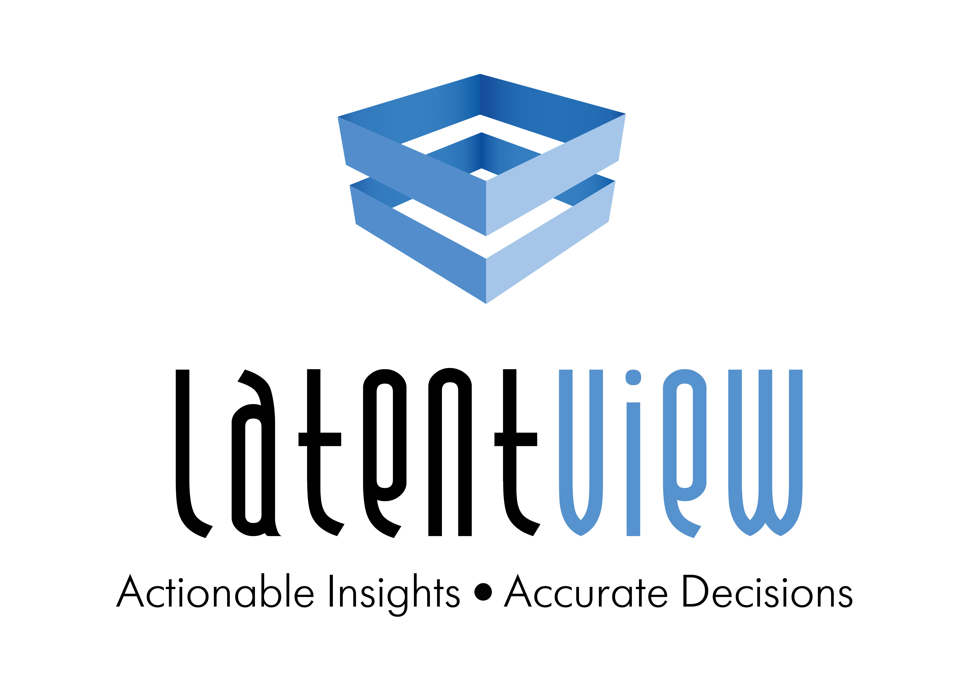
Thank You
Fabian Cortes
434-531-3335
Fabian.Cortes@LatentView.com

